Slide 1
HIKER

Slide 2
Hiker is a website designed for anyone who enjoys the outdoor trails and all they have to offer
Hiker allows you find local trails to hike based on difficulty
Hiker gives hiking enthusiasts and novices alike a quick, easy place to find community
Interact with the community by leaving reviews about what you liked and or disliked about the trails

Slide 3
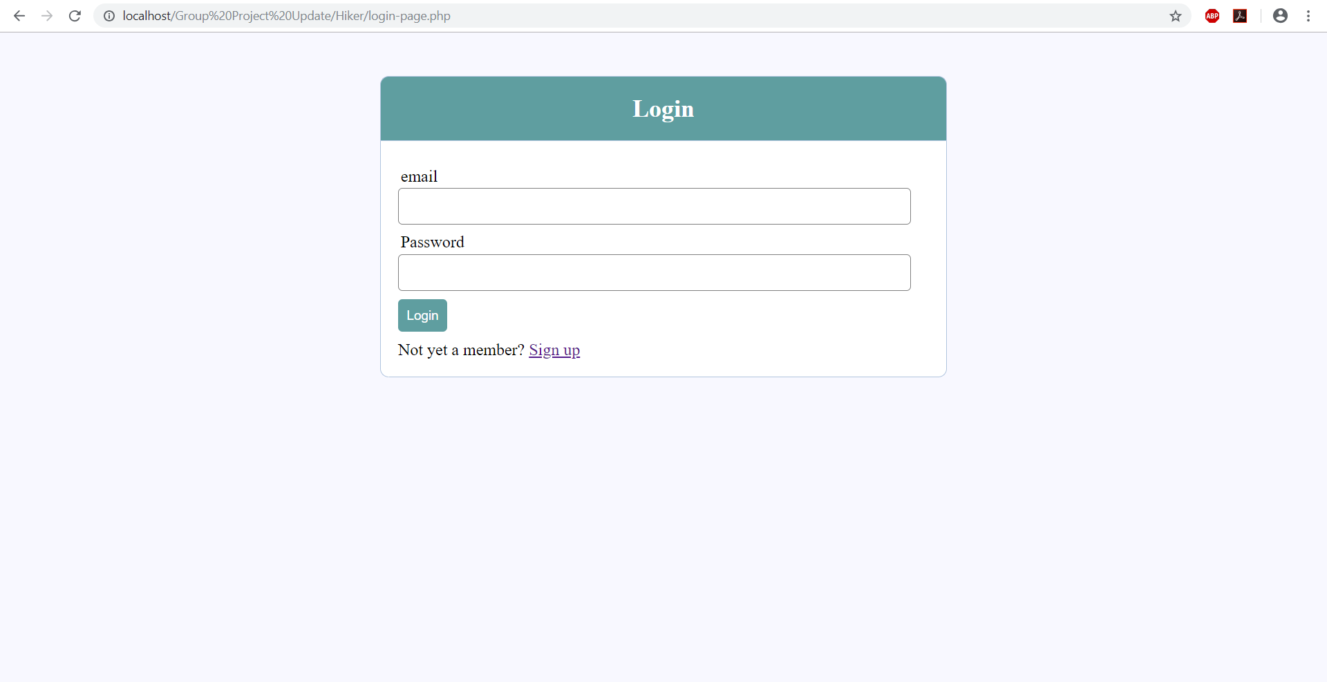

Slide 4
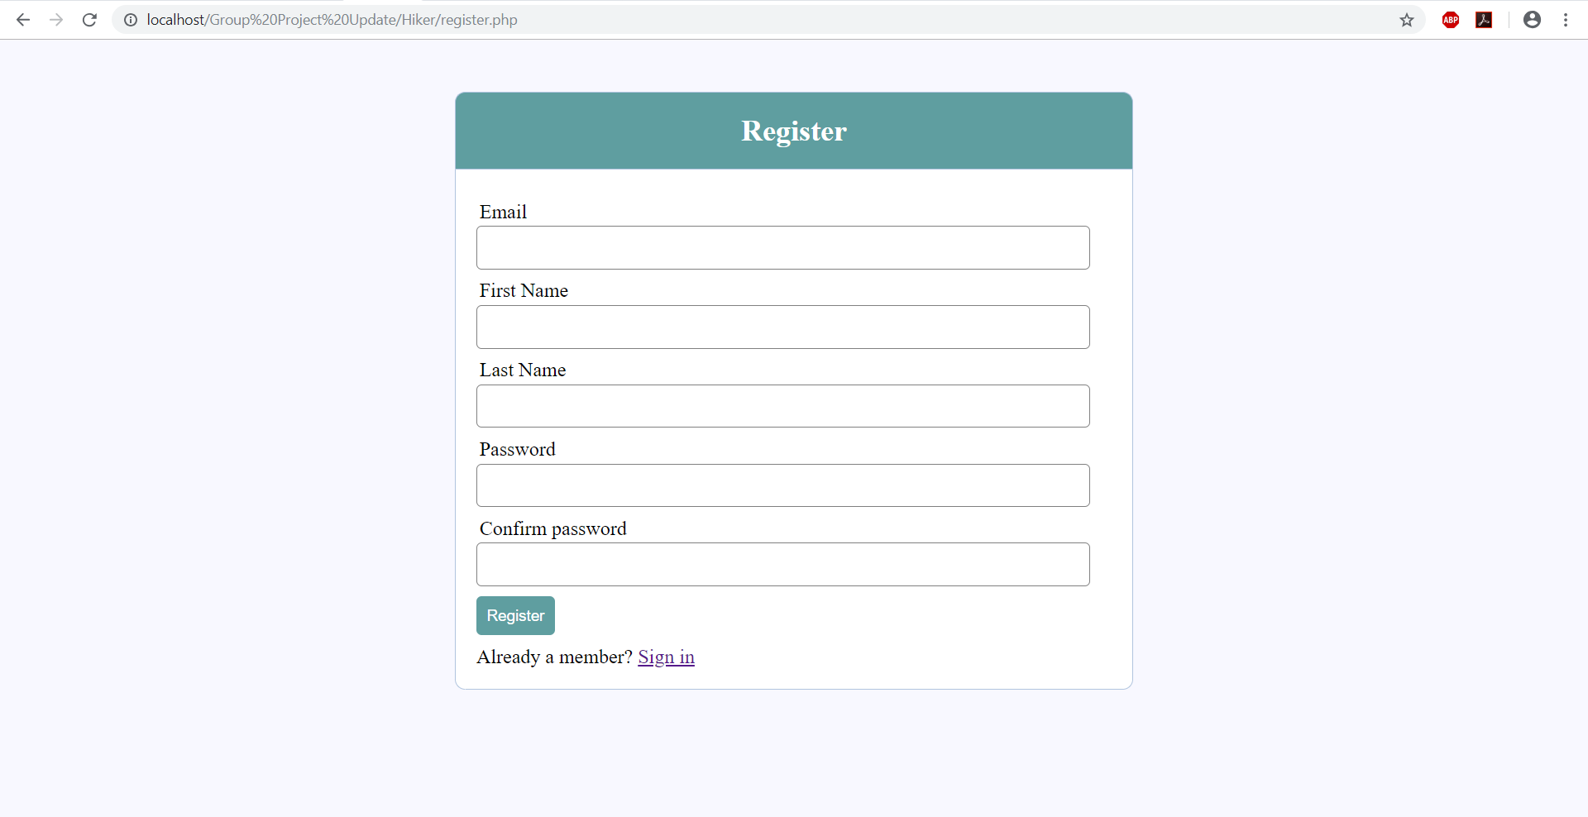

Slide 5


Slide 6
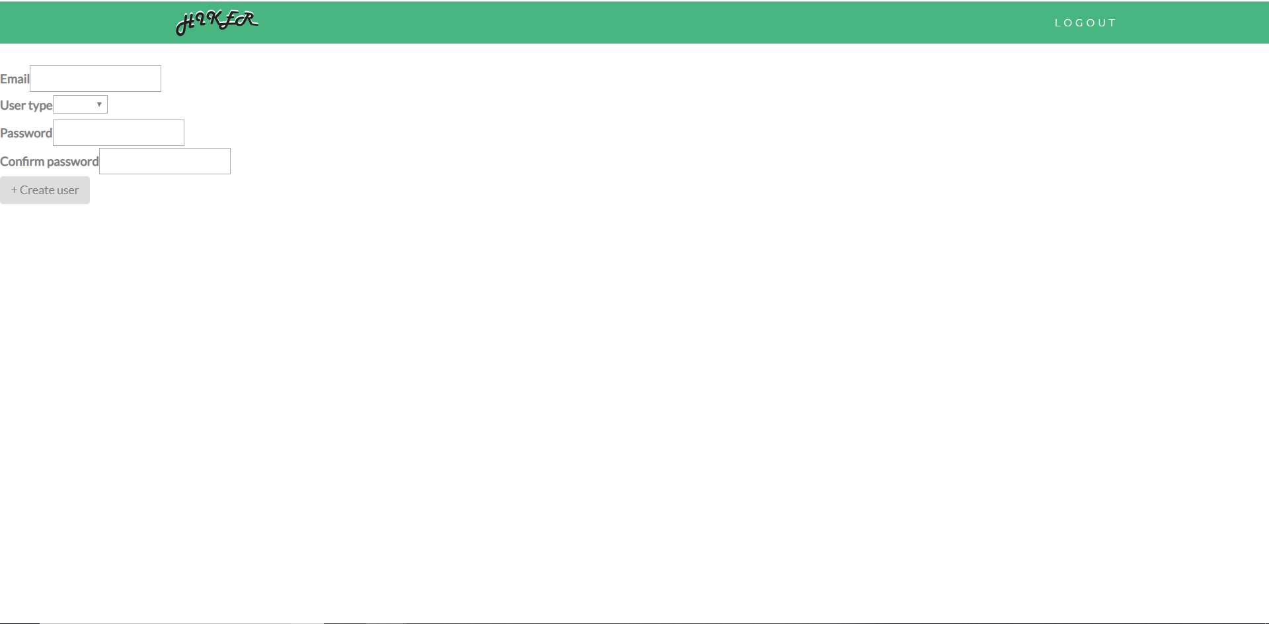

Slide 7


Slide 8
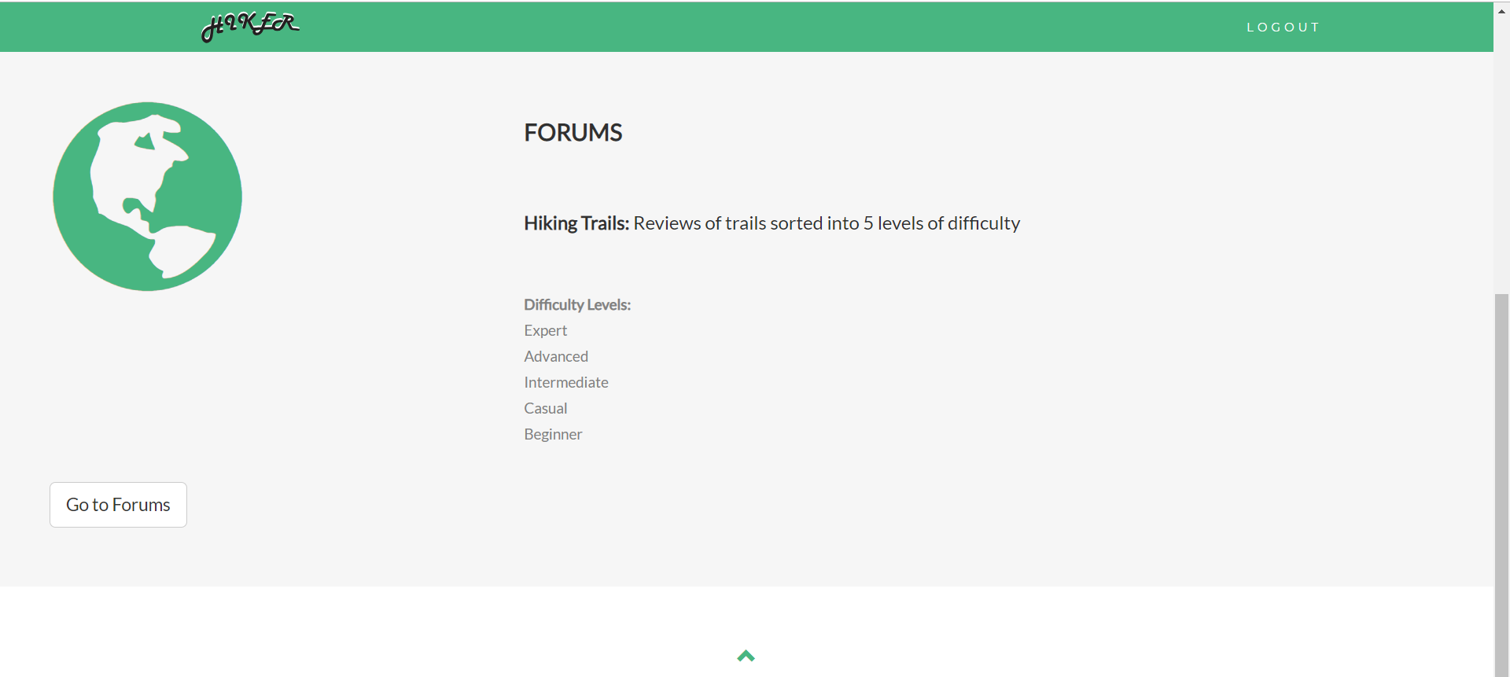

Slide 9
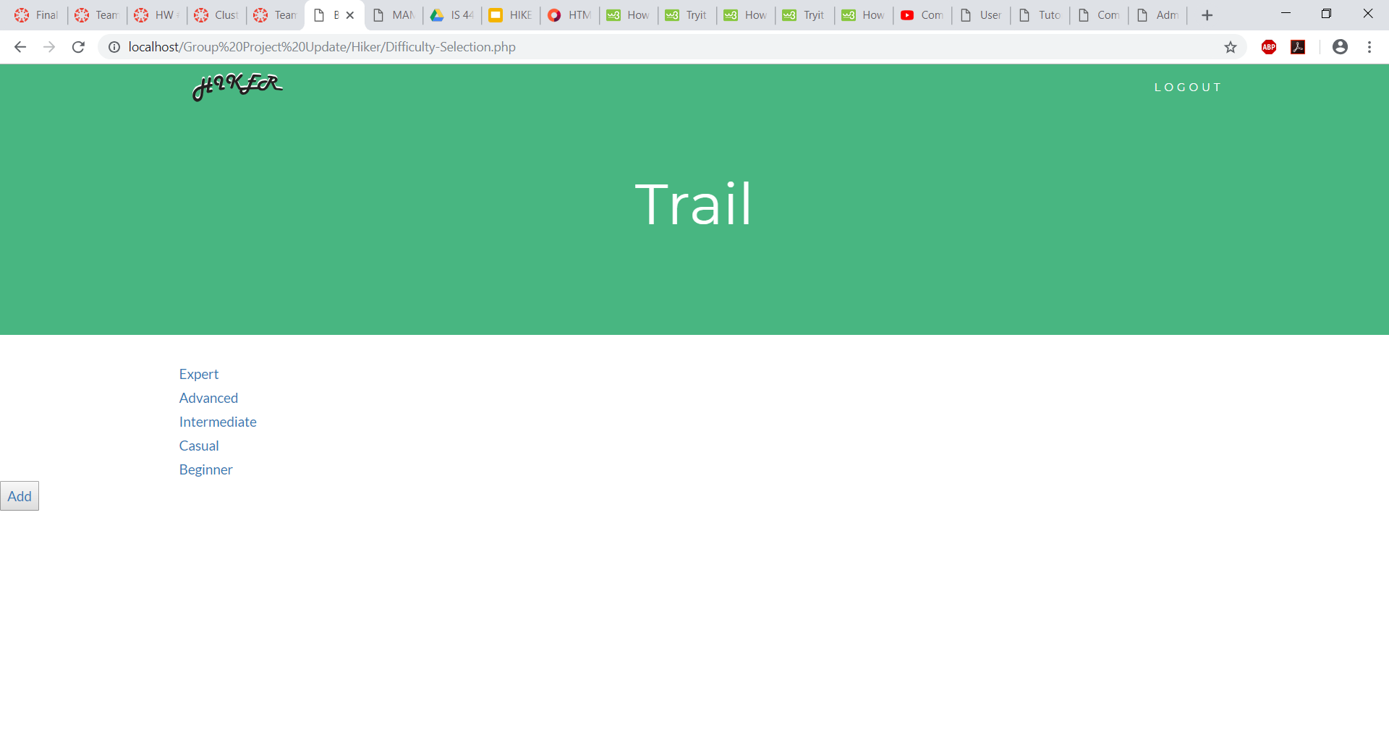

Slide 10


Slide 11
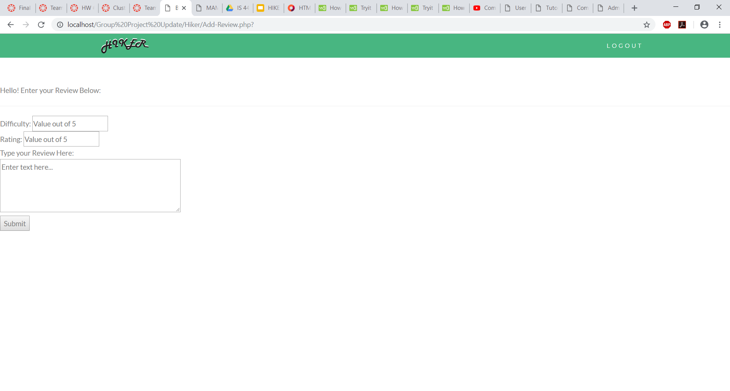

Slide 12
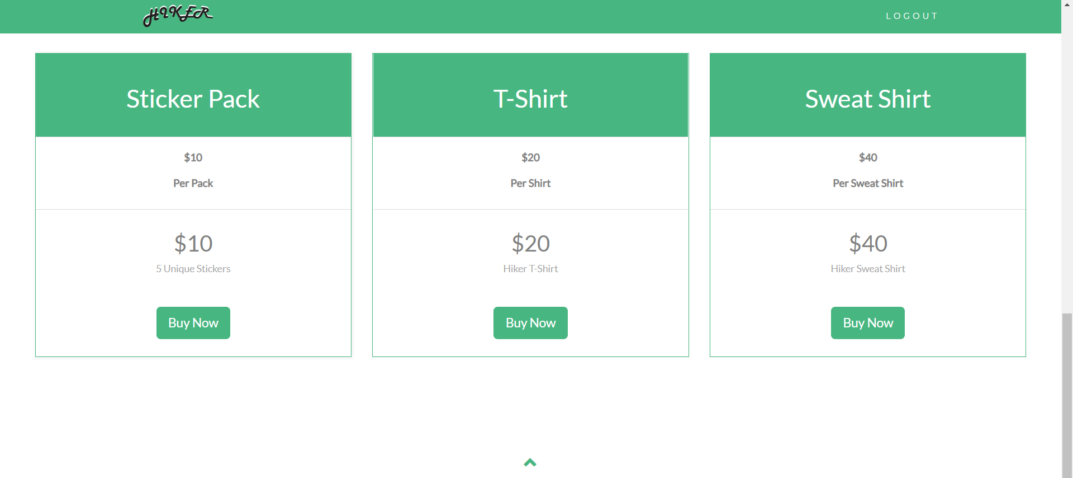

Slide 13
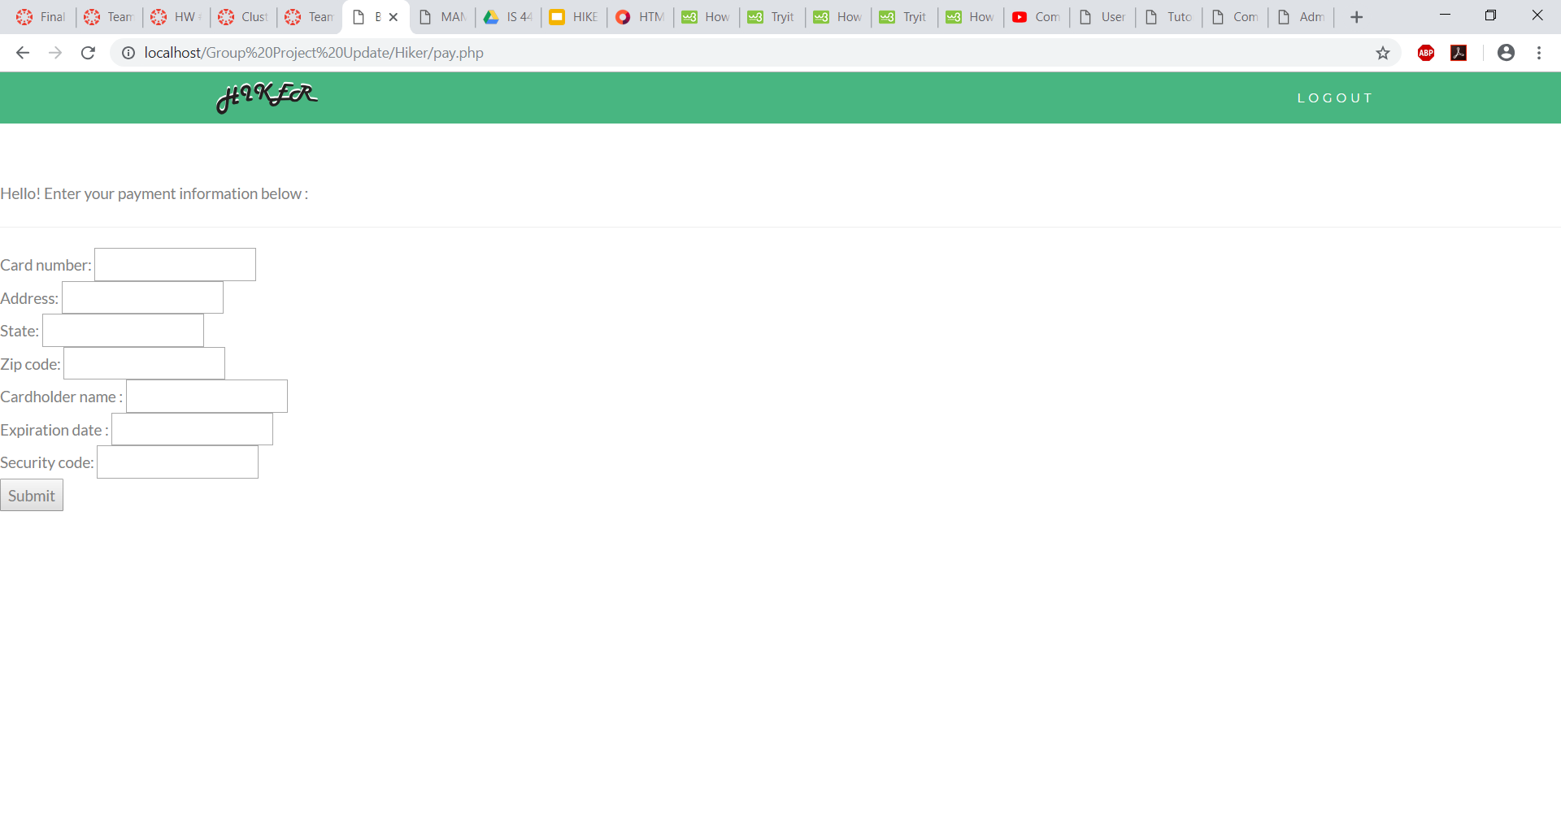

Slide 14


Slide 15
